Slide 1
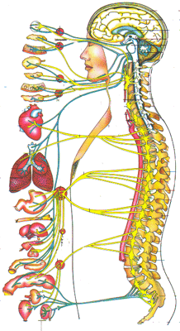
Central Nervous System:
Speech & Language

Slide 2
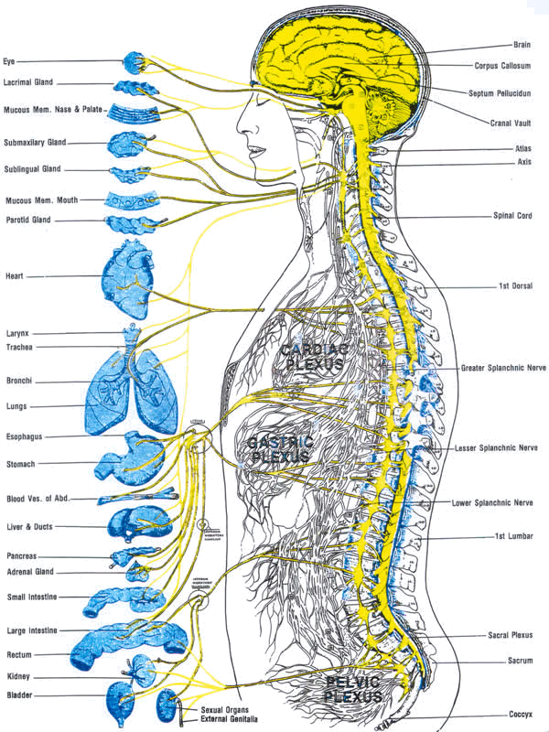
The nervous system is important for moment and speech
Movement
respiration
phonation
articulation
all aspects of:
  speech production
  speech perception

Slide 3
The nervous system divisions
CNS
  brain and spinal cord
  glial cells
    astrocytes
  oligodendrocytes
    forms myelin

Slide 4
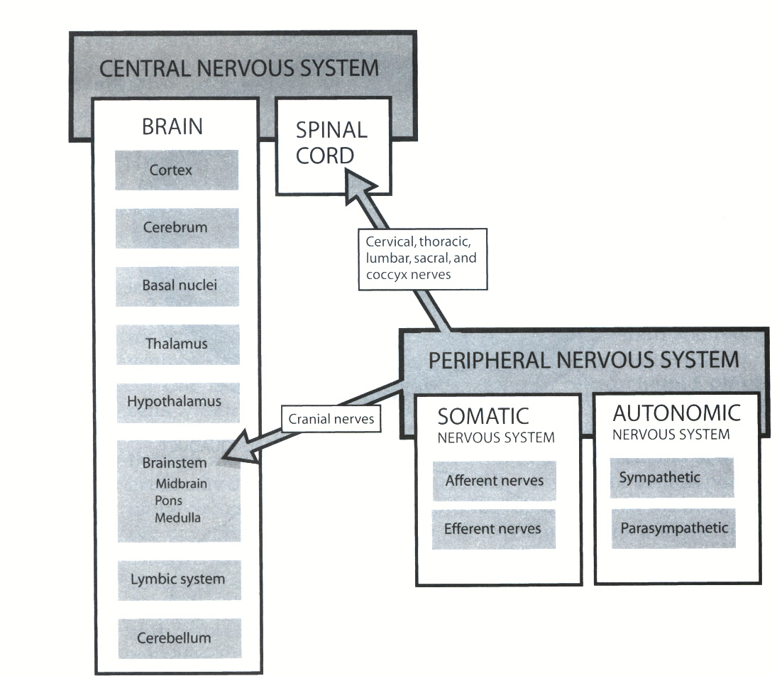
CNS

Slide 5
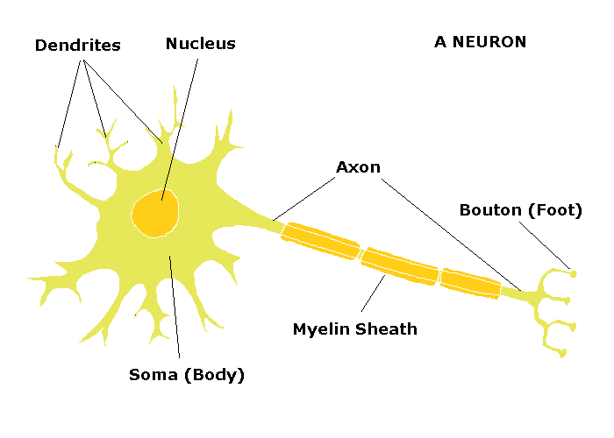
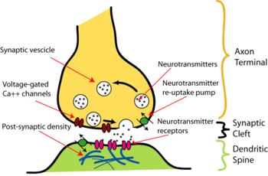
The neuron is the basic unit of the nervous system
dendrites
cell body
axon
terminal boutons
synapse
myelin
nodes of Ranvier
neurotransmitters

Slide 6
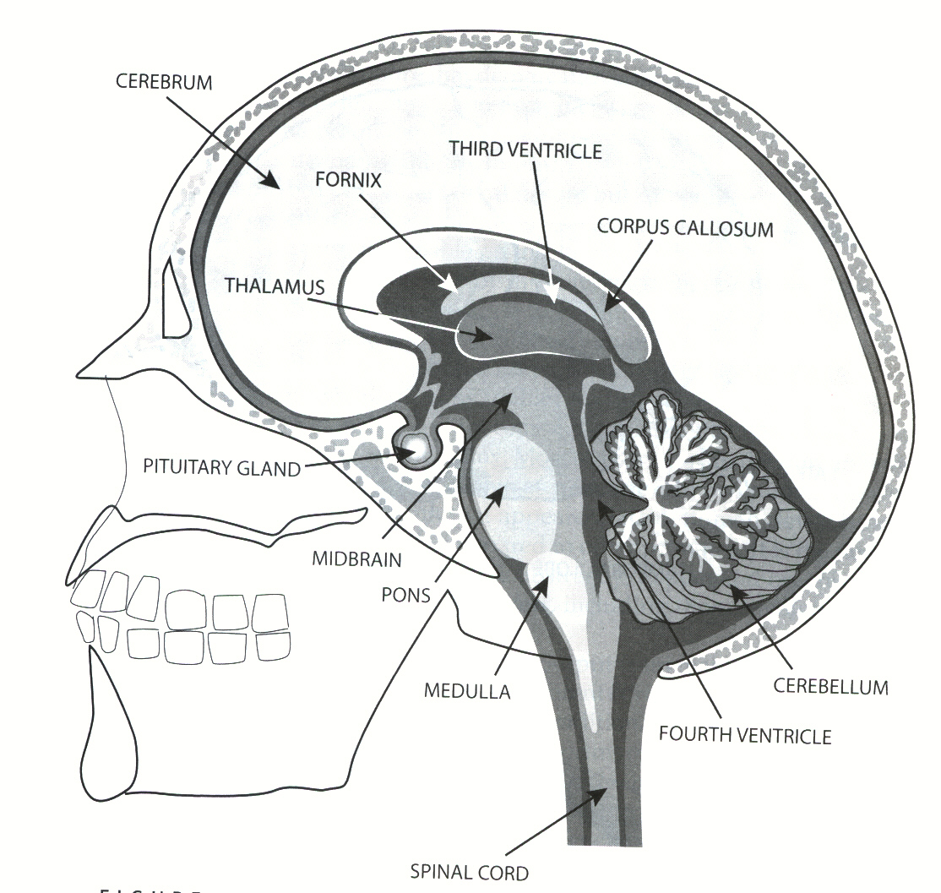
CNS

Slide 7
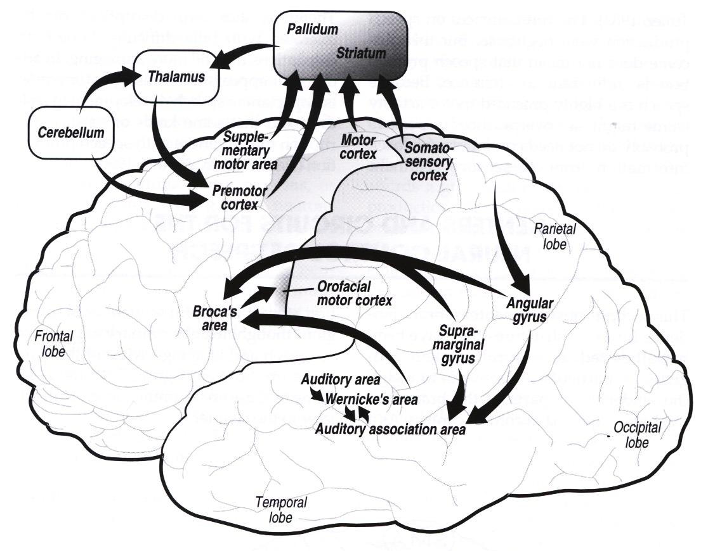
Speech Language Areas

Slide 8
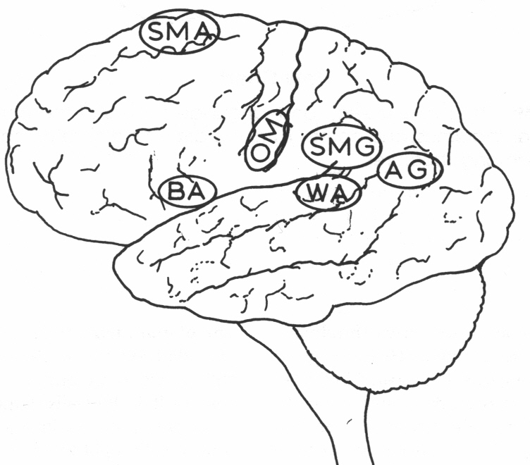
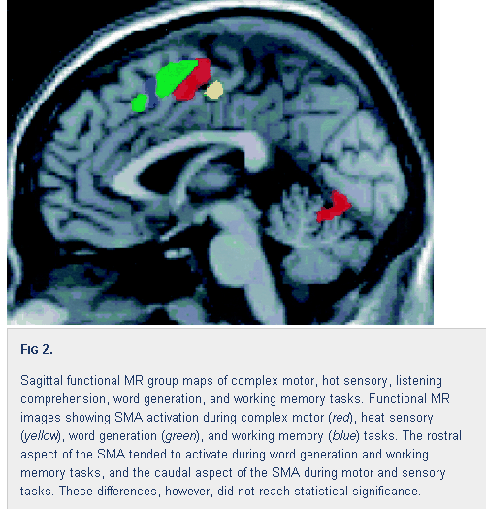
Speech/Language Areas
Supplementary Motor Area:
Motor, sensory, word generation, and working memory.

Slide 9
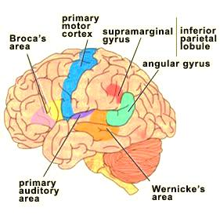
Speech/Language Areas
Supramarginal Gyrus
Thought to contribute to written language and possible phonological storage as well as visual word recognition.

Slide 10
Speech/Language Areas
Angular Gyrus
(1) Association areas and allows cross modal transfer and associations between either vision or touch and hearing (2). As the angular gyrus is important in the processing of associating a heard name to a seen or felt object, it is probably also important for associations in the reverse direction. A "name" passes through Wernicke's area, then via the angular gyrus arouses associations in the other parts of the brain (2). Thus, the angular gyrus acts as a way station between the primary sensory modalities and the speech area.(2).
The development of language is probably heavily dependent on this area. Object naming, one of the simplest aspects of language, depends on associations between other modalities and audition

Slide 11
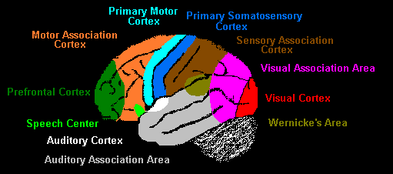
Cerebral Cortex
Frontal Lobe- associated with reasoning, planning, parts of speech, movement, emotions, and problem solving
Parietal Lobe- associated with movement, orientation, recognition, perception of stimuli
Occipital Lobe- associated with visual processing
Temporal Lobe- associated with perception and recognition of auditory stimuli, memory, and speech

Slide 12
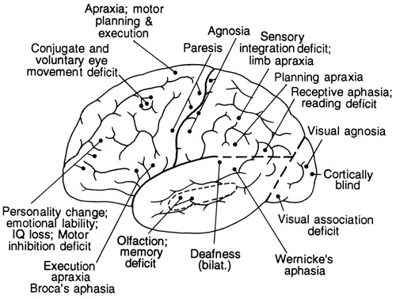

Slide 13
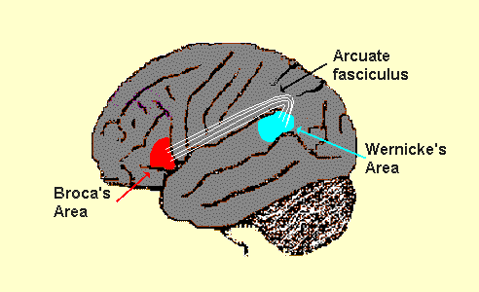
Neuro-speech-language

Slide 14
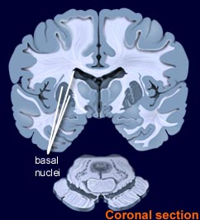
Subcortical areas of the brain play a primary role in motor function
basal ganglia/nuclei
  caudate nucleus, putamen and globus pallidus.

Slide 15
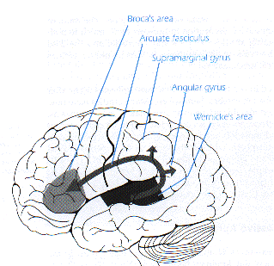
Language Zone

Slide 16
Speech Language Areas

Slide 17
Speech/Language Areas
Supplementary Motor Area:
Motor, sensory, word generation, and working memory.

Slide 18
Speech/Language Areas
Supramarginal Gyrus
Thought to contribute to written language and possible phonological storage as well as visual word recognition.

Slide 19
Speech/Language Areas
Angular Gyrus
(1) Association areas and allows cross modal transfer and associations between either vision or touch and hearing (2). As the angular gyrus is important in the processing of associating a heard name to a seen or felt object, it is probably also important for associations in the reverse direction. A "name" passes through Wernicke's area, then via the angular gyrus arouses associations in the other parts of the brain (2). Thus, the angular gyrus acts as a way station between the primary sensory modalities and the speech area.(2).
The development of language is probably heavily dependent on this area. Object naming, one of the simplest aspects of language, depends on associations between other modalities and audition

Slide 20


